Slide 1

Getting activated
Mental preparedness and Psychological awareness

Slide 2
To act or not to act – The Action Bias
Mental preparedness and Psychological awareness
Just like physical skills, psychological ones can be taught, learned, and practiced. In understanding human behavior, both in individuals and in groups, you can develop these psychological skills and use them to heighten your awareness, foster your talents and abilities, and reach your peak performance
https://www.youtube.com/watch?v=oJIJwGFRoLg
The concept of performance— a goal- directed behavior— plays a central role in contemporary culture. Everyone wants to perform better— not only in their careers, but also in their hobbies, relationships, and in pretty much everything else they do. And to perform better in any situation, it is necessary to focus on and develop the psychological skills that help lead to success

Slide 3

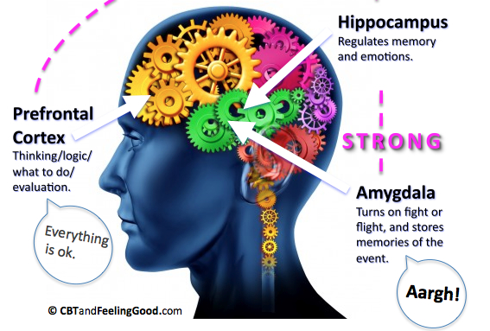
Arousal Is a Lot of Stress Really That Bad?
Arousal—a psychophysiological state of being awake or reactive to stimuli (i.e., general alertness and readiness to respond)— is the underpinning of stress, anxiety, pressure, and even motivation
The concept dates back thousands upon thousands of years to our distant prehistoric ancestors

Slide 4
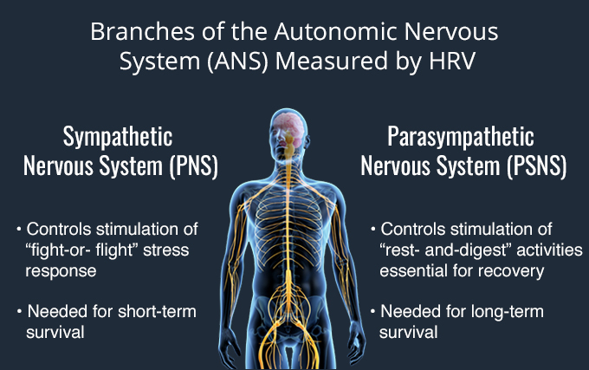
In business, as in sports, one may not be handling life and death situations such as soldiers in battle or a prehistoric person facing off against a tiger, but arousal, or high levels of stress, can be used to your benefit in both everyday and extraordinary circumstances
Understanding how to healthily and positively handle and harness stress makes one
more productive
lead a happier and more inspired life

Slide 5
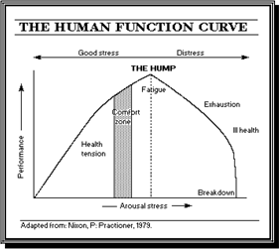
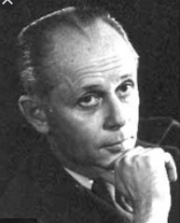
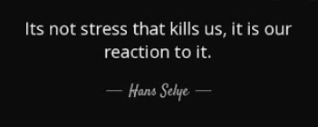
The concept of stress

Slide 6
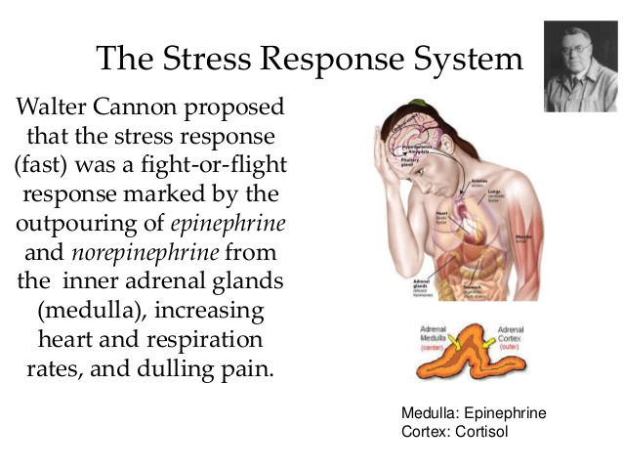

Slide 7
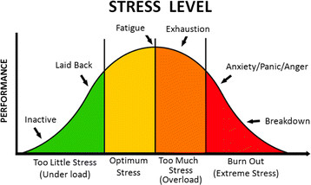
STRESS AND PERFORMANCE Stress is not necessarily something bad, it all depends on how you take it - Hans Selye
Yerkes Dodson Law- Stress arousal and Performance
A classic experiment conducted in 1908 by Robert M. Yerkes (1876– 1956), a pioneer of American psychology, and his colleague John D. Dodson, is highly relevant to the question of how stress influences performance
They investigated “the relation of strength of stimulus to rapidity of habit- formation,” (Journal of Comparative Neurology and Psychology)
They discovered that mild electrical shocks could effectively be used to cause mice to acquire the habit of completing a maze. If the electrical shocks were too mild or too strong, however, the mice’s performance in the maze decreased. From this they developed what is now called the Yerkes- Dodson law which shows a curvilinear relationship between stress and performance

Slide 8
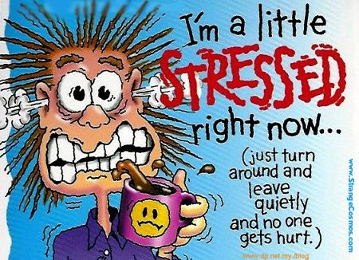
Types of Stress
ACUTE
STRESS
CHRONIC STRESS
Episodic Acute Stress

Slide 9
Episodic acute stress and its Symptoms
When acute stress happens frequently, it’s called episodic acute stress
Displays prolonged effects of acute stress
Negative health effects
Personality is an important factor for developing acute stress
Symptoms of extended over arousal
Persistent tension headaches
Migraines
Hypertension
Chest pain
Digestion problems
Resistant to change

Slide 10
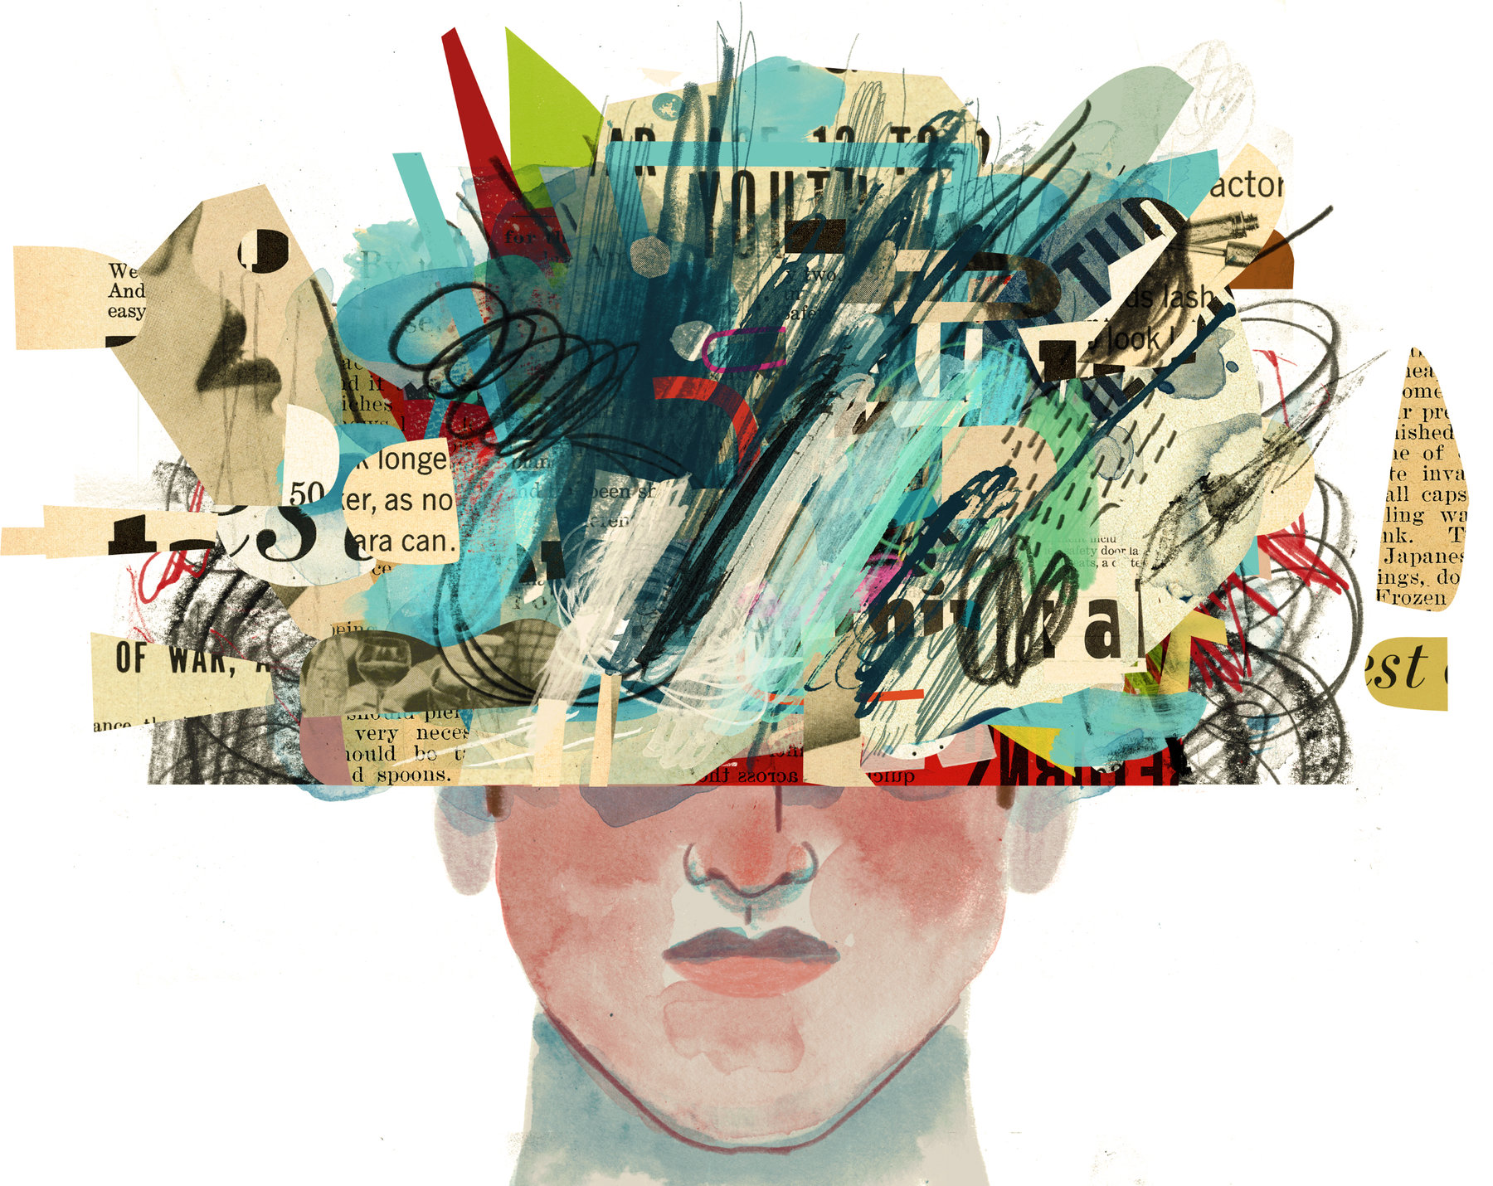
Chronic Stress
Grinding stress that wears people away day after day year after year
Warfare
Financial crisis
Traumatic experiences
Chronic illnesses
Dysfunctional families
Creates LEARNED HELPLESSNESS
Dealing with chronic stress increases psychosomatic problems

Slide 11

Common signs of stress
Effect of stress on
performance
Physical signs
Dry mouth
Difficulty breathing
Pounding heart
Stomach-ache
Chronic headache
Psychological signs
sudden irritability
problems concentrating
Difficulty sleeping
Narrowed perception
Frequent feelings of fatigue
Stress affects appetite and digestion
Stress affects cognition

Slide 12
Stress and its physiology
The brain reacts to stress in a series of neural and chemical reactions that are meant for physical survival
Stress caused by
biological agents – viruses
environment – temperature
psychological agents – threat to self esteem, loss of loved one resulting in loneliness, social isolation etc

Slide 13
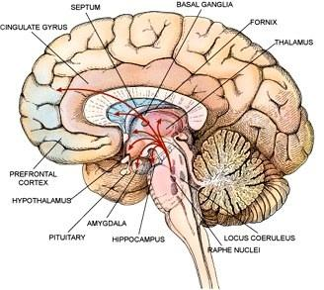
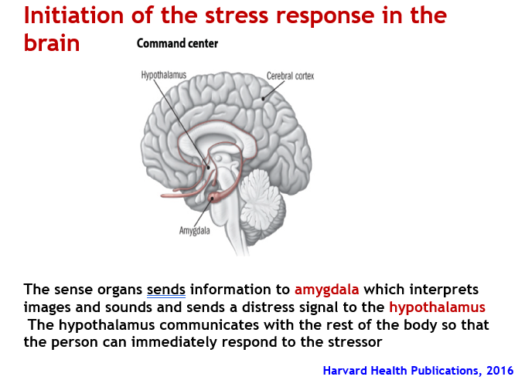
Physiological Systems Involved in the Stress Response
The nervous system
The endocrine system
The immune system
Optimally, interaction of these systems maintains homeostasis and wellness

Slide 14
Triggering the HPA axis
The Hypothalamic Pituitary Adrenal Axis or HPA axis – best known for its role in body’s natural reaction to stress
HPA axis includes a group of hormone secreting glands from the
NERVOUS and ENDOCRINE SYSTEM
This network consists of the Hypothalamus, the Pituitary gland and the Adrenal glands
When one experiences a stressful event:
The hypothalamus releases a hormone called the Corticotrophin Hormone (CRH)
CRH signals the Pituitary Gland to secrete the Adreno Cortico Tropic Hormone (ACTH) into the blood stream
ACTH travels down to the Adrenal glands where it prompts the release of Glucocorticoids from the Adrenal Cortex
One of these Glucocorticoids is Cortisol which plays an important role in stress response
With increased cortisol level 🡪 Epinephrine and Norepinephrine (hormones) secreted from Adrenal Medulla

Slide 15
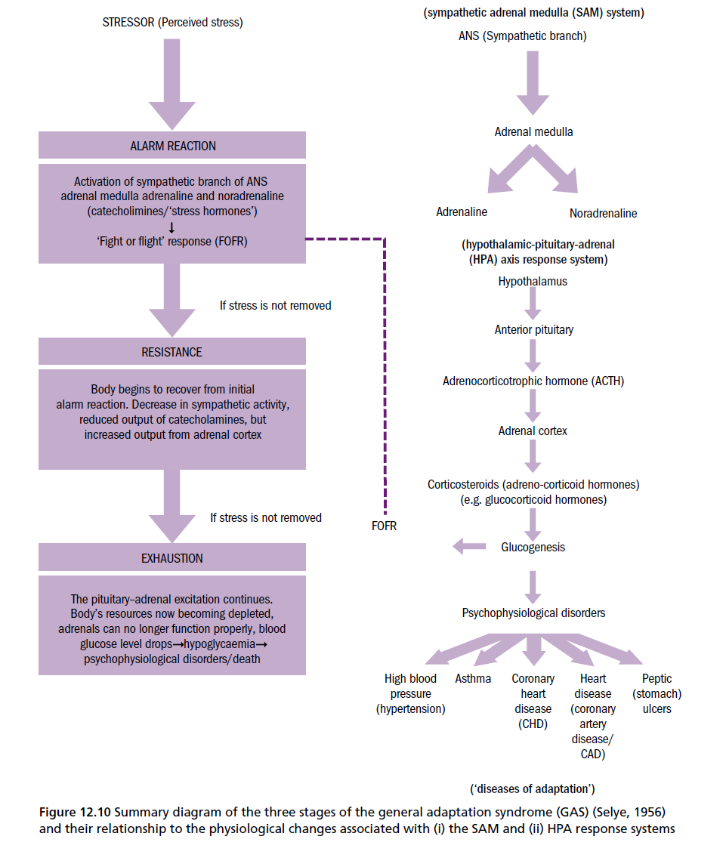
HPA axis…
As epinephrine circulates through the body, it brings on number of physiological changes:
The heart beats faster than normal
pushing blood to the muscles, heart, and other vital organs
Pulse rate and blood pressure go up
The person undergoing these changes also starts to breathe more rapidly
Small airways in the lungs open wide - the lungs can take in as much oxygen as possible with each breath. Extra oxygen is sent to the brain, increasing alertness
Thus, Sight, hearing, and other senses become sharper
The release of cortisol causes number of changes that helps the body deal with stress
Eg: Helps body mobilise energy like glucose so that body has enough energy to cope with prolonged stress
When the threat passes, cortisol levels fall
The parasympathetic nervous system — the "brake" — then dampens the stress response

Slide 16
WHY DO INDIVIDUALS BEHAVE DIFFERENTLY DURING STRESS?
Stress depends on how an individual perceives a situation
Perception of the ability to cope with the situation
The individual's judgment that a stressful situation exists, initiates a stress response
Without this appraisal there is no stress in the person's psychological schema
Individual differences
cognitive reaction to a situation - appraisal of the nature, importance and implications of the event, and by your ability to effectively manage or cope with the event
emotional responses to a situation - determined by appraisal of situation and coping abilities
Ex: “I can handle this,” – planning ways to handle the situation
“This is terrible. I’m going crazy” - quitting, getting more anxious
Importance of knowing physiology of stress:
If one understands the physiology of stress, then one can begin to use this knowledge to augment one’s own health and well-being through different stress management techniques
It is important to know what happens to our body during a stressful situation…

Slide 17
Factors of Personality related to stress
Locus of control
Self esteem
Personality Type
Hardiness

Slide 18
Main Characteristics of Type A Behavior
A sense of time urgency and hostility - A feeling that there is not enough time to do all the things that we believe should be done or that we wish to do.
symptoms:
Rapid movements: The afflicted person usually walks, talks or eats fast
Impatience: There is a feeling that the rate at which most events take place is too slow
Anguish at waiting in line or waiting to be seated in a restaurant. Avoids repetitive tasks
Tension: finds it difficult to sit and do nothing. Feels guilty when relaxing He often has a characteristic facial tautness expressing tension and anxiety
Restlessness: knee jiggling, rapid tapping of the fingers, head nodding, rapid eyebrow lifting while speaking, sucking in air while speaking, tongue-to-front-teeth clicking during conversation, or tuneless humming
Preoccupation: Inattentive to others. Unable to detect mental and physical fatigue while engaged in a task. Fails to observe seemingly unimportant unrelated things
2. Hostility – a predisposition to evaluate people or events negatively, often in a suspicious, distrustful, cynical, and paranoid fashion
There is a generalized aggression or excessive competitive drive

Slide 19
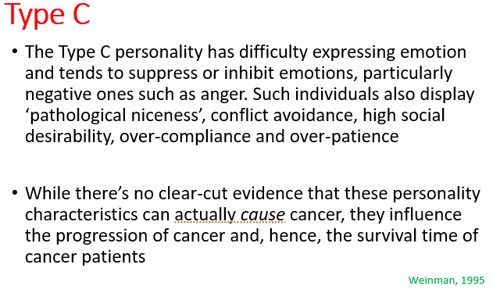
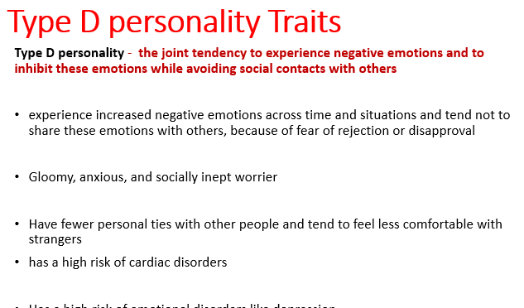
Other Personality Types
Type B People with Type B personality tend to be more tolerant of others, are more relaxed than Type A individuals, more reflective, experience lower levels of anxiety and display higher level of imagination and creativity
Type A Personality – Jenkins Activity Survey
Online version for college students - www.psych.uncc.edu/pagoolka/TypeA-B-intro.html

Slide 20

Developing resilience to stress

Slide 21
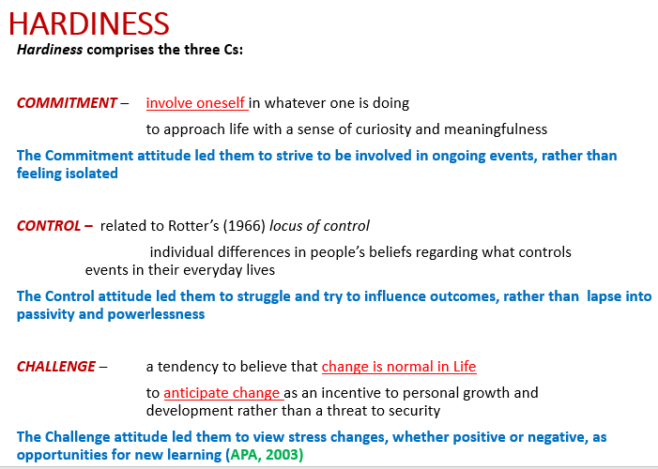
HARDINESS
Hardiness moderates the stress–illness relationship by reducing cognitive appraisals of threat, and reducing the use of regressive coping

Slide 22
Are you serious about stress?
Learning about stress can produce similar problems
You can understand the stress reaction, and even note the signs of stress in your everyday life, yet still have little idea of what to do about it
Simply knowing about stress is not enough Achieving real control over stress requires something more: an understanding of the unique patterns that stress takes in your life
This personal understanding is necessary because the actual patterns that trigger stress reactions vary enormously from one person to the next
There is an old joke about a man who went to a psychiatrist because of a problem with thumb-sucking. After several months of therapy, the patient was delighted with the results and was describing them to a friend. "So," the friend said, "you don't suck your thumb any more?" "Oh, no," replied the patient, "I still suck it as much as ever. But now I know why!“

Slide 23

Understanding your stress level

Slide 24
Stress mapping…
sensitize yourself to potential stressors in the environment
(Ask, yourself, when it is that you feel stressed and discover an event preceding it)
keep a stress journal or notebook, a day-by- day account of when and where the signs of stress appear
Helps in developing self control as it reveals the patterns of stress, those unique configurations of stressor and response that operate in your life
Personal stress analysis - a method by which you systematically evaluate and interpret the information in the journal
This analysis, when well grounded in your examination of potential stressors and in your careful observation of your own behavior, can then serve as the basis for the subsequent development of a comprehensive program of stress management
Knowing your personal stressors and how you react to them provides a tremendous opportunity for you to alter your behavior, coping more efficiently or perhaps avoiding stressful situations altogether

Slide 25
Work on your stress level
Format for a stress Journal
Date and Time:
Signal of stress:
Duration of symptom:
Events prior to the symptom:
Events when symptoms stopped:
Discover patterns of stress operating in your life
Be aware of these signs of physical and mental response to stress
Identify the triggers
Analyze the relationship between the stress reaction and the stressful situation that evoked it
Set realistic and effective stress control
Shaffer, M, 1982

Slide 26
Bodily symptoms
How many of these symptoms do you have now/ in recent past?
Motor Symptoms (muscles involved)
Feeling States
Cognitive States
Flushing
Sweating
Dry mouth
Shallow breathing
Chest oppression and pain
Heart palpitation
Pounding pulse
lncreased blood pressure
Headache
-Backache
Feeling of weakness
Intestinal distress
Vomiting
Diarrhea
Constipation
Fatigue
Loss of appetite
Nervous chill
Insomnia
restlessness
Flatus (passing gas)
Belching
Abdominal cramping
"Irritable colon"
Dizziness or faintness
Paresthesias (illusory prickly skin
sensations)
Agitation
Shakiness
Easy tiring
Worry
Panicky feeling
Depression (feeling blue)
Irritability
Dread
Inattention
Distractibility
Forgetfulness
Nightmares
Fear of death
Muscular tightness
Tremors
Tics (spasms)
Increased startle reaction
Incoordination
Sighing
Freezing, feeling immobilized

Slide 27
Daily Practices
As an Individual
Aim for an optimal state of stress and arousal to keep you on your toes, staying involved and productive, without overworking yourself or entering a state of chronic stress
Remember that obstacles and tasks are subjective— your personal perception can be a major determinant in how you handle stress and how it affects your performance
Make complex tasks simpler by employing chunking techniques, breaking down your actions into smaller, discrete units
As a Leader
Find the sweet spot when it comes to your personal levels of stress and that of the group, you’re leading
The environment that leaders create and cultivate is crucial to employee performance— talk to your team about what works best for them and see how you can incorporate their preferences into the surrounding environment
Recognize that there will be Type A and Type B people on your team, and you will have to motivate them accordingly— the Type A group will likely need help decreasing stress and anxiety while Type B will need some added pressure

